Slide 1
Developing an automated VR cognitive treatment for psychosis: gameChange VR therapy
Journal of Behavioral and Cognitive Therapy 2020
中科院SCI医学2区

Slide 2
Introduction
1. The automation of evidence-based treatments using VR could allow services to substantially scale up the provision of effective psychological therapy.
2. The overwhelming majority of the VR interventions tested to date have relied on a therapist being present to deliver the psychological techniques, greatly limiting the scalability of these treatments.
3. This paper describes the development process for gameChange, an automated VR cognitive therapy targeting the highly prevalent anxious social avoidance in psychosis.

Slide 3
The gameChange project
1. Four main objectives:
(1) To develop a powerful VR treatment.
(2) To identify the barriers and facilitators for the implementation of the VR therapy and produce an implementation plan.
(3) To conduct a multisite randomised controlled trial testing the clinical effectiveness and cost effectiveness of the gameChange VR therapy.
(4) To create a commissioning case and commercialisation plan to enable the rolling out of this intervention across the UK’s National Health Service.

Slide 4


Slide 5
The gameChange project
2. Design
(1) In total 53 people with psychosis experience contributed to the design of the gameChange therapy.
(2) Lived Experience Advisory Panel (LEAP) was set up consisting of ten people with lived experience of psychosis.
(3) Software development was carried out by Oxford VR.

Slide 6
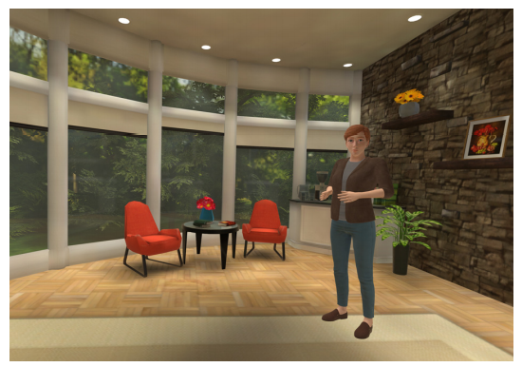
The gameChange project
3. VR coach: Patients are asked to rate their confidence in managing everyday situations
before selecting the scenario they wish to try.

Slide 7
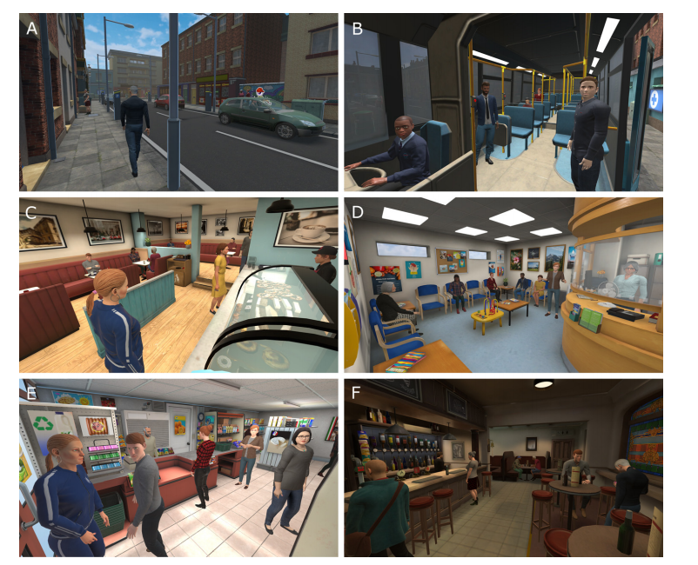
The gameChange project
4. Scenarios: patients have to carry out key tasks such as ordering a drink, finding items in shop or calling across a room to someone.
(1) Street
(2) Bus
(3) Cafe
(4) Doctor’s waiting room
(5) Corner shop
(6) Pub

Slide 8
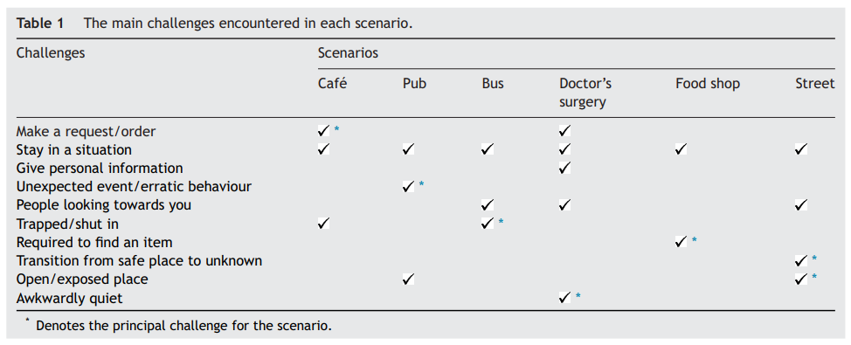
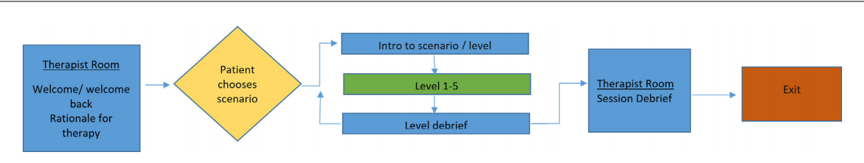

Slide 9
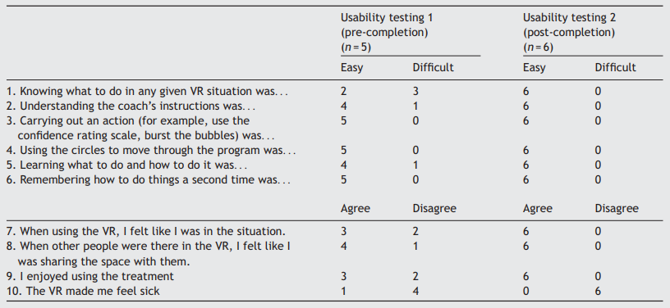
Experiments
1. Usability testing.

Slide 10
Experiments
2. Controlled trial:
(1) 432 patients with psychosis who are anxious going into everyday situations.
(2) VR therapy and usual care.
(3) The trial will be completed in January 2021.
(4) www.gamechangevr.com.

Slide 11
下周计划
写毕业论文。
阅读一篇论文。

